Slide 1
Timeless Prescription及Prime全新產品推出
Isotonix & Prime - new products launch
Emmy Yeung
產品拓展經理
Product Manager
本簡報中提到的收入等級純屬舉例說明，無意代表美安香港超連鎖™店主的一般收入，也無意表示任何超連鎖™店主皆可賺取同等收入。美安香港超連鎖™店主的成功與否，取決於其在發展事業時的努力、才能與投入程度。
The income levels mentioned in the following presentation are for illustration purposes only. They are not intended to represent the income of a typical Market Hong Kong UnFranchise ™Owner, nor are they intended to represent that any given Independent UnFranchise ™ Owner will earn income in that amount. The success of any Market Hong Kong Independent UnFranchise ™ Owner will depend upon the amount of hard work, talent, and dedication which he or she devotes to building his or her Market Hong Kong Business.

Slide 2
Retail Driven Company
Base 10, Seven Strong
MA Brands MPCP $

Slide 3
NEW CUSTOMERS
BUILD SHARE OF CUSTOMER
RETAIL TO RECRUIT
RECRUIT TO RETAIL
WHAT DO YOU WANT?

Slide 4
Markets We Serve
MILLENNIALS
1980 – 1996
20 - 37 Age
GEN X
1965 – 1979
38 – 52 Age
BABY BOOMERS
1946 – 1964
53 – 71 Age
GEN Z
1996 – 2015
2 – 21 Age
Notes:
http://www.dh.gov.hk/english/statistics/statistics_hs/files/Health_Statistics_pamphlet_E.pdf
Population and Vital Statistics for 2016
Mid-Year Population (‘000): 7336.6
Below 15 years: 830.5 (11.3%)
25 – 64 years: 5342.9 (72.8%)
65 years and above: 1163.2 (15.9%)

Slide 5
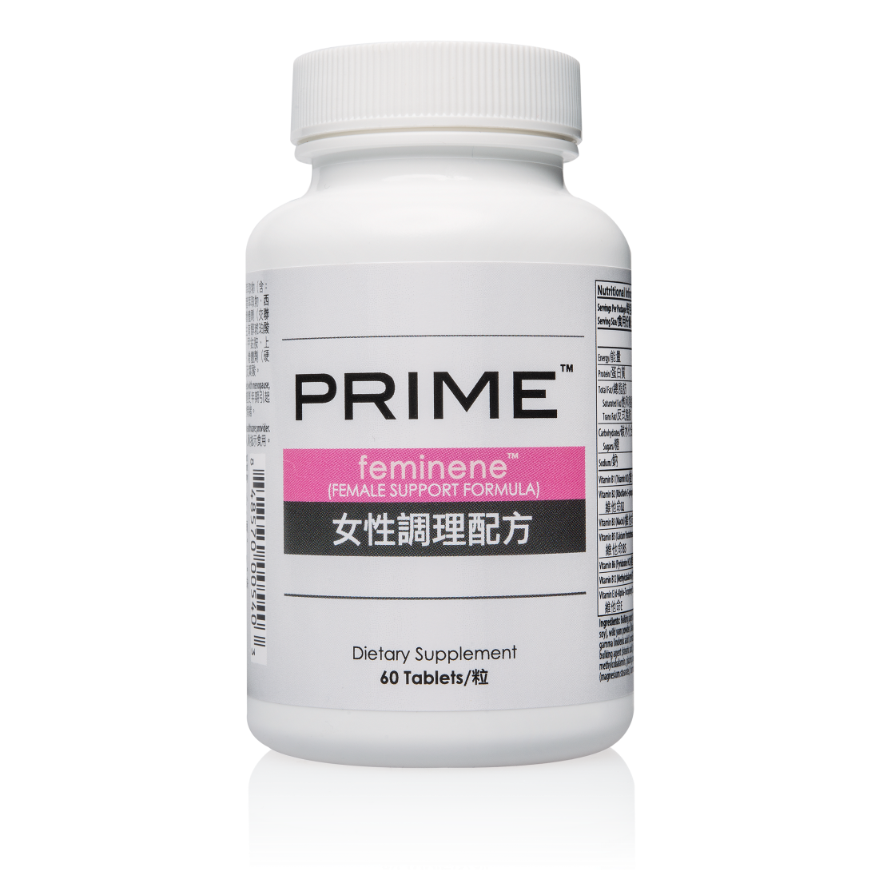
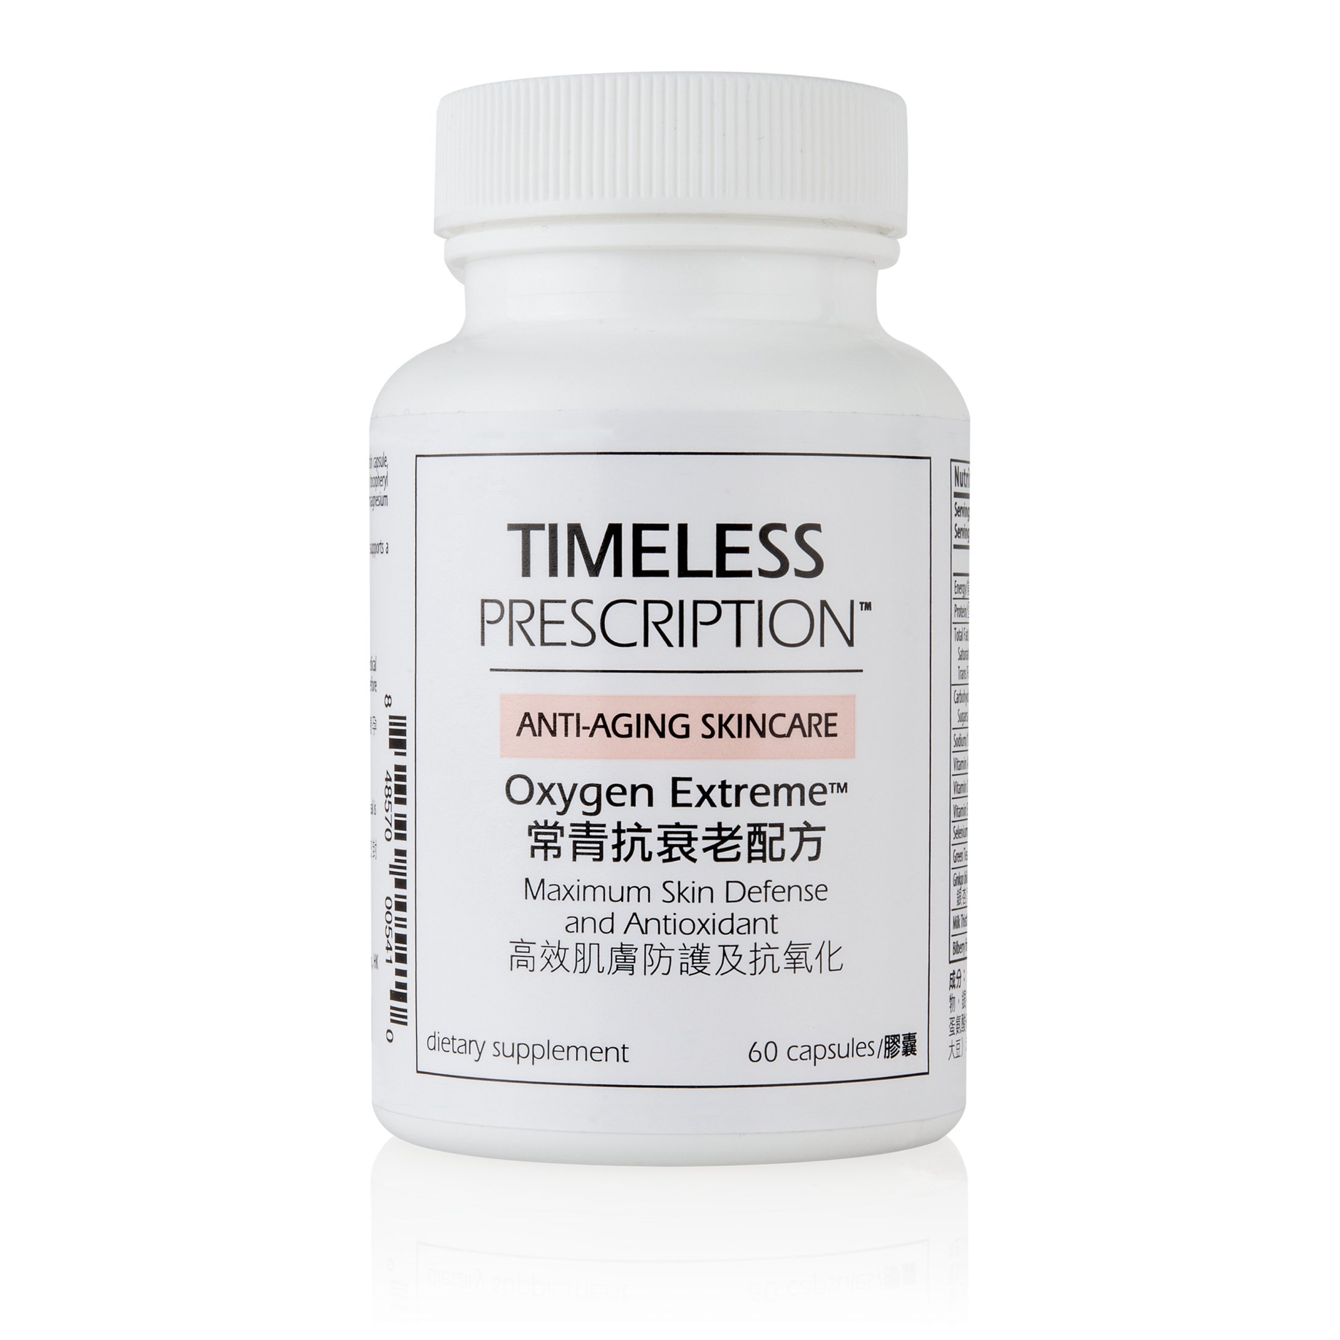
New Product Spotlights

Slide 6
Timeless Prescription及Prime全新產品推出
Timeless Prescription & Prime - new products launch
Stephen Ngan
保健營養市場推廣部主管
JAS & Associates
本簡報中提到的收入等級純屬舉例說明，無意代表美安香港超連鎖™店主的一般收入，也無意表示任何超連鎖™店主皆可賺取同等收入。美安香港超連鎖™店主的成功與否，取決於其在發展事業時的努力、才能與投入程度。
The income levels mentioned in the following presentation are for illustration purposes only. They are not intended to represent the income of a typical Market Hong Kong UnFranchise ™Owner, nor are they intended to represent that any given Independent UnFranchise ™ Owner will earn income in that amount. The success of any Market Hong Kong Independent UnFranchise ™ Owner will depend upon the amount of hard work, talent, and dedication which he or she devotes to building his or her Market Hong Kong Business.

Slide 7
抗氧化保護和女士健康
Antioxidant Protection and Women’s Health
Stephen Ngan
JAS & Associates
保健營養巿場推廣部主管
Head of Healthcare Marketing,
JAS & Associates
此演講的內容並未受美國食品及藥物管理局評核。此產品並非作為診斷、醫療或預防任何疾病或狀況之用途。The statements contained in this presentation have not been evaluated by the Food and Drug Administration. This product is not intended to diagnose, treat, cure or prevent any disease.

Slide 8
Oxidative stress:
Overproduction of free radicals
Overproduction of free radicals > oxidative stress > damage of body cells

Slide 9
Oxidative stress:
Due to today’s modern life styles / environment
— pollutants we inhale
— excess to ultra-violet light
— illnesses
Increasing scientific evidence linking cell damage to chronic diseases, e.g. cancer, cardiovascular disease, diabetes mellitus and aging.

Slide 11
Anti-oxidative action of vitamin C & vitamin E
Normal body process: formation of free radicals
O2 = essential component of living organisms
Body cells: energy producing processes + O2 > formation free radicals
Normal circumstances: free radicals are constantly produced

Slide 12
Anti-oxidative action of vitamin C & vitamin E
Anti-oxidants: protect body cells against overproduction of free radicals
Dietary anti-oxidants: substances (nutrients) in food, neutralise free radicals, protect body cells against overproduction
Anti-oxidants:
- vitamin C & E

Slide 13
Vitamin C
Vitamin C is one of the more powerful and well-known antioxidants. Just as exposing a cut from an apple to air causes it to quickly turn brown, cells of the body can also suffer when exposed to oxygen, a process known as oxidation.
Can react with many reactive oxygen species (ROS) and reactive nitrogen species (RNS)
Can regenerate vitamin E

Slide 14
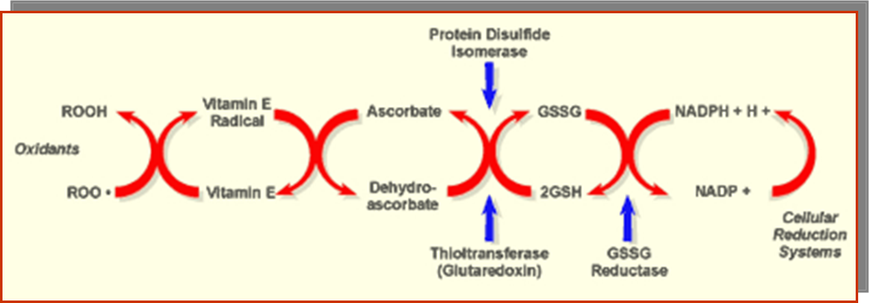
Anti-oxidative action of vitamin C & vitamin E
Adapted from: Packer L, Weber SU & Rimbach G (2001): Molecular aspects of alpha-tocotrienol antioxidant action and cell signalling. J. Nutr. 131,369S–373S

Slide 15
Vitamin E
Vitamin E protects the body from excessive oxidation, a normal aging process by which oxygen breaks down the body’s tissues.

Slide 16
Vitamin E
It works to neutralize free radicals, which are naturally occurring unstable molecules that can damage the body’s healthy molecules by taking electrons to balance themselves. When enough vitamin E is present in the body, unstable free radicals get their electrons from the vitamin E molecules and leave the healthy molecules alone, thus promoting the health of tissues.

Slide 17
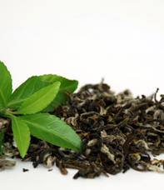
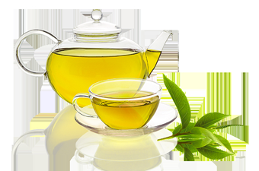
Green Tea
Unlike the processing of black tea, the oxidation process of green tea is halted by the application of heat and this accounts for the higher polyphenol content found in green tea.

Slide 18
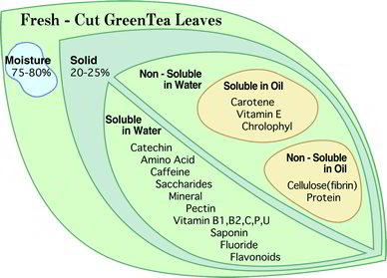
Image courtesy of https://teatropolitan.wordpress.com

Slide 19
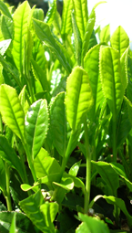
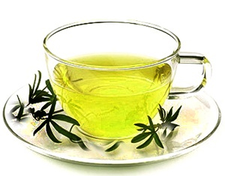
Green Tea
Green tea has long been studied for its powerful antioxidant properties. It has also been reported to support cardiovascular health

Slide 20
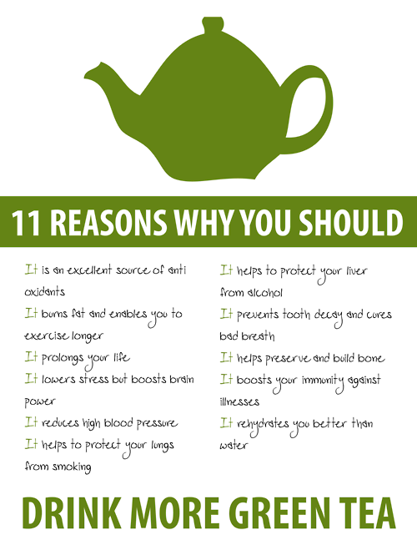
Photo courtesy of http://theteacupoflife.com/2012/11/drink-more-green-tea.html

Slide 21
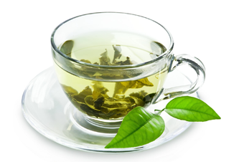
Green Tea
The catechins in green tea have also been correlated with providing positive effects on mood.

Slide 22
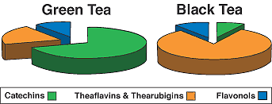
Comparison between green tea and black tea
Adapted from http://lpi.oregonstate.edu/mic/food-beverages/tea#table-1

Slide 23
Green Tea Extract
Green Tea Extract is a health-promoting antioxidant. It is rich in polyphenols that have been shown to promote health.

Slide 24
Selenium
Selenium promotes the body’s production of glutathione peroxidase, the body's master antioxidant.
Selenium is an essential trace mineral that works closely with vitamin E to provide the body with powerful antioxidant protection from free radicals.

Slide 26
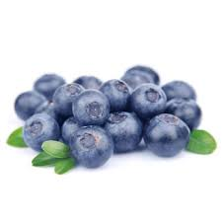
Bilberry
Bilberry’s chief action as an antioxidant is its powerful synergy with vitamin E.
Bilberry anthocyanosides also supports the operation of crucial enzymes in the enzymes in the retinal cellular metabolism and function.
Bilberry promotes normal platelet activity.

Slide 27
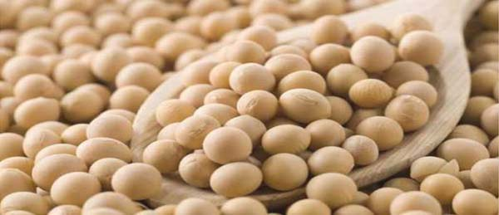
Soy Extract
Soy extract contains isoflavones in the form of phytoestrogens. Phytoestrogens are nonsteriodal compounds that come from plants.
Soy may be linked to alleviating mild menopausal symptoms and beneficial in promoting bone health.

Slide 28
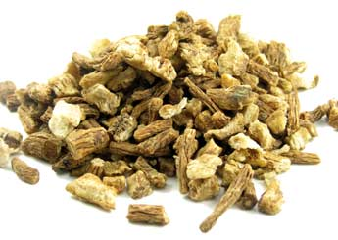
Dong Quai Root Extract
Dong quai is often referred to as the female ginseng because of its homeostatic effects during menstruation.
Its most common use is to manage mild cramps and pain during menstruation as well as to alleviate some of the mild symptoms of menopause such as hot flashes.

Slide 29
Dong Quai Root Extract
The specific mechanism of action is unknown; although, coumarin, ferulic acid and ligustilide appear to be the active constituents of the dong quai root.
Coumarin aids in promoting normal blood flow, while the ferulic acid and ligustilide promote normal muscle relaxation. Dong quai is not a replacement for estrogen (although, some studies have shown that it has a similar effect as isoflavones) nor does it have any hormone-like effects on the body.

Slide 30
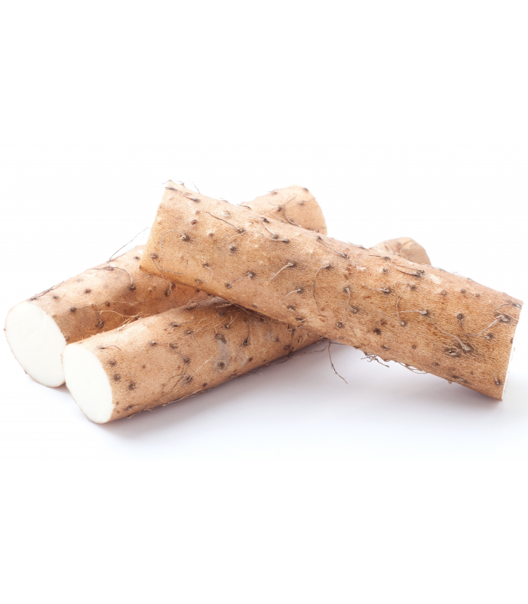
Wild Yam
Wild yam has been historically used for mild symptoms associated with menstruation and menopause, including cramping, hot flashes and occasional fatigue.

Slide 31
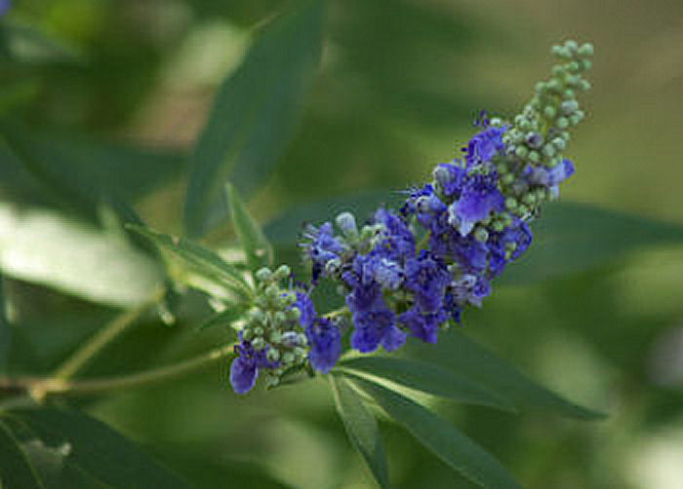
Chasteberry Extract
It is generally used in dietary supplements for mild symptoms of PMS and menopause. The flavonoids casticin, isovitexin and orientin are the main constituents of chasteberry extract. It is often used to promote a healthy menstrual cycle.

Slide 32
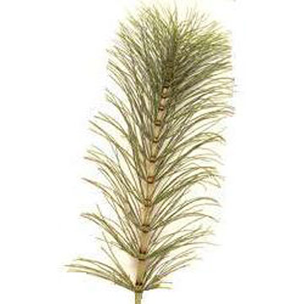
Horsetail Extract
Horsetail (Equisetum arvense), also known as Peterwort, Dutch rushes, Shave-grass and Bottlebrush, is named from the bristly appearance of its jointed stems.
It has the ability to draw excess water from the body, which makes it useful for cleansing the body.
Horsetail is a natural source of silicon, iron and sodium, and also contains high amounts of calcium, chromium, crude fiber, magnesium, potassium, selenium and vitamin A.
Horsetail has been shown to be helpful with mild symptoms of PMS and menopause.

Slide 33
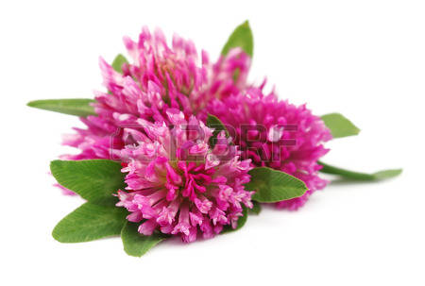
Red Clover Extract
Red clover, like soy, contains high levels of isoflavones. Red clover has been shown to help alleviate hot flashes associated with menopause.

Slide 34
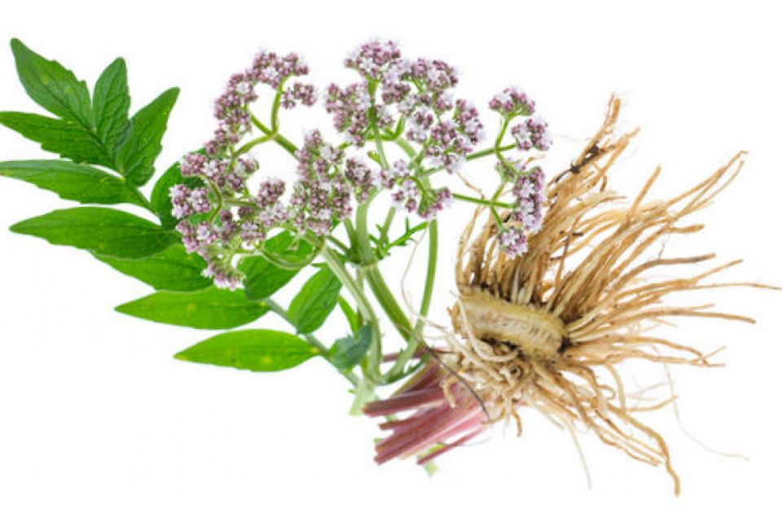
Valerian Extract
The Ancient Greek physician Galen referred to valerian as “Phu,” which is an expression of disgust at the plants smell. It was given the name all-heal in medieval times due to its natural healing properties.
Valerian Root is commonly used to as a natural sleep aid, but it is also used for mild symptoms associated with premenstrual syndrome and menopause. Clinical trials have shown that extracts of the root have a sleep-inducing effect, which researchers believe stems from the herb’s tendency to boost levels of gamma-aminobutyric acid, a chemical messenger in the brain.

Slide 35
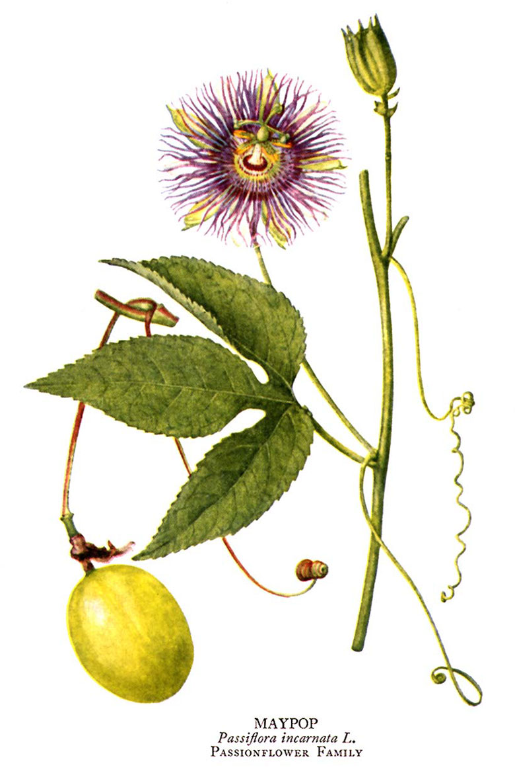
Passion Flower Extract
Passiflora, also known as the passion flower, can be used as an effective support for occasional sleep difficulty and restlessness.

Slide 36
Red Sage Extract
It has been used for a variety of purposes, including helping to control hot flashes. The herb acts specifically on the uterus to help alleviate mild adverse symptoms of PMS including cramps. It is also good for relieving excessive perspiration from hot flashes.

Slide 37
Vitamin B
The B vitamins are a group of eight vitamins: thiamine (B1), riboflavin (B2), niacin or niacinamide (B3), pantothenic acid (B5), pyridoxine (B6), biotin (B7), folic acid (B9), and cobalamine (B12).
These several vitamins, traditionally have been grouped together and have a number of similarities: properties, physiological functions and distribution in natural sources
All the B vitamins, like vitamin C, are soluble in water, in contrast to the fat-soluble vitamins A, D, E, and K

Slide 38
Why take Vitamin B?
Support and increase the rate of metabolism
Maintain proper heart pulse rate
Enhance immune, nervous system & brain function
Promote cell growth and division — including that of the red blood cells that help prevent anemia

Slide 39
Symptoms of Vitamin B Deficiency
Hair loss, stunted nail growth, skin rashes, cracks on lips and cracks in the corner of the mouth
Tiredness, listless feelings, mental problems, crying spells, or an inability to cope
Indigestion
Heart palpitations, heart arrhythmias or fibrillation
Tingling in hands, feet, and toes
PMS or peri-menopausal symptoms
Chronic fatigue, soreness all over or chronic exhaustion
Lack of energy, problems with the adrenal glands

Slide 40
B-complex
B1 may help protect adrenal glands from exhaustion
B2, B3, B6, folic acid needed for phase I liver detoxification
Pantethine may slow stress-induced cortisol production
B12 helps provide energy and regulate circadian rhythms, improve sleep quality

Slide 41
Riboflavin (Vitamin B2)
Vitamin B2 supports healthy growth of skin, nails and hair and plays a crucial role in turning food into energy as a part of the electron transport chain, driving cellular energy on the micro-level. Vitamin B2 supports the breakdown of fats. Vitamin B2 cannot be stored by the body except in insignificant amounts; thus, it must be replenished daily.

Slide 42
Vitamin B
High doses of B vitamins have been used by practitioners to alleviate mood disorders and psychiatric symptoms, including anxiety, mild depression, nervousness, and poor memory.

Slide 43
Study of vitamin B
Study showed some improvements in depression outcomes associated with folate supplementation. Evidence also suggests that folate deficiency is associated with reduced serotonergic and/or neurotransmitter function, and a poorer response to antidepressant medication.
(Coppen et al 1986, Godfrey et al 1990, Passeri et al 1993, Coppen and Bailey 2000)

Slide 44
10 Advantages of Increasing Vitamin B Intake
Increased energy
Promotes healthy stress management
Supports mental health
Encourages healthier looking hair and nails
Reduces dry, flaky skin and rashes
Supports iron absorption and prevents anemia
Improves circulation
Strengthens cardiovascular health
Reduces side effects of diabetes
Promotes healthy metabolism and weight loss

Slide 45
Timeless Prescription及Prime全新產品推出
Isotonix & Prime - new products launch
Emmy Yeung
產品拓展經理
Product Manager
本簡報中提到的收入等級純屬舉例說明，無意代表美安香港超連鎖™店主的一般收入，也無意表示任何超連鎖™店主皆可賺取同等收入。美安香港超連鎖™店主的成功與否，取決於其在發展事業時的努力、才能與投入程度。
The income levels mentioned in the following presentation are for illustration purposes only. They are not intended to represent the income of a typical Market Hong Kong UnFranchise ™Owner, nor are they intended to represent that any given Independent UnFranchise ™ Owner will earn income in that amount. The success of any Market Hong Kong Independent UnFranchise ™ Owner will depend upon the amount of hard work, talent, and dedication which he or she devotes to building his or her Market Hong Kong Business.

Slide 49
Understanding about Menopause…
When a woman reaches the age of 45 to 55, her ovaries produce less estrogen and progesterone.
When a woman has not had menstruation for over a year, she is considered to have reached menopause.
Lowering of estrogen levels results in physiological and psychological changes:
Hot flushes
Mood Swings
Excessive Sweating, especially during hot flushes
Headache, dizziness, fatigue, insomnia
Irregular menstruation
Osteoporosis
Notes:
http://www.fhs.gov.hk/english/health_info/faq/women_health/WH2_5_5.html
http://www.fhs.gov.hk/english/health_info/woman/14768.html

Slide 50
INTRODUCING...
CODE: HK13181| UC: HK$225.00 | SR: HK$315.00 | BV: 20

Slide 51
INGREDIENTS
Black Cohosh Root Extract
Soy Extract
Dong Quai Root Extract
Wild Yam Powder
Chasteberry Extract
Horsetail Extract
Red Clover Extract
Valerian Extract
Passion Flower Extract
Vitamins and Minerals…

Slide 52
BENEFITS
Supports feminine health
Helps to reduce hot flashes and night sweats associated with menopause
Helps alleviate mild symptoms commonly associated with menopause
May support mood stabilization
Helps counteract mild effects of PMS

Slide 53
THE MARKET
Gen Z (adults over 18)
Millennial
Gen X – especially those who have entered menopause stage
Baby Boomers

Slide 54
VALUE PROPOSITION
Vegetarian product. Contains no gluten, wheat, yeast, artificial flavors or preservatives
Helps to reduce hot flashes and night sweats associated with menopause
Specially formulated with select nutrients
UC: $225.00 | SR: $315.00 (profit: $90.00 (40%) | BV: 20 (8.8%)
30 Servings - $10.50 a serving

Slide 55
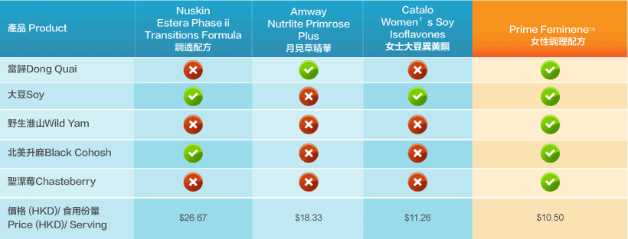
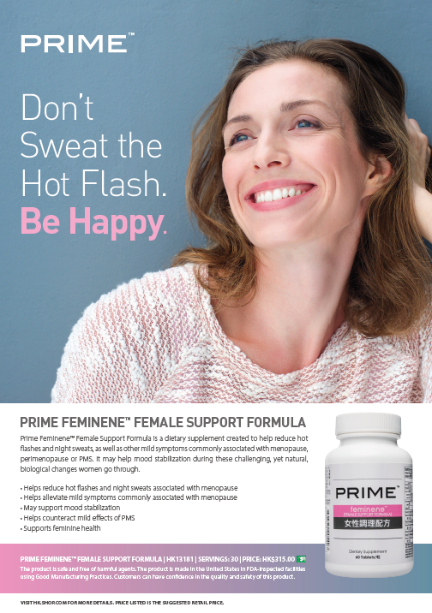
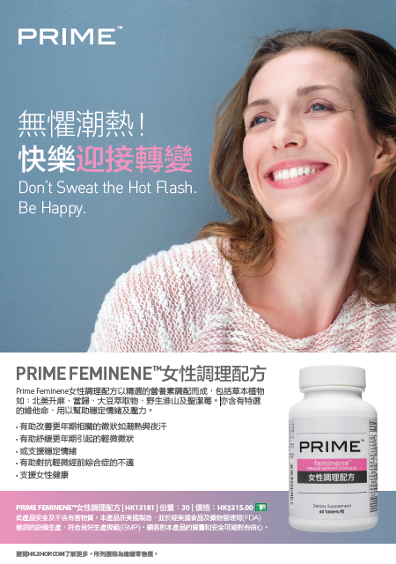
VS. Competitors & Sales Tool

Slide 59
INTRODUCING...
CODE: HK6101| UC: HK$166.00 | SR: HK$233.00 | BV: 14

Slide 60
INGREDIENTS
Vitamin A (Beta-Carotene)
Vitamin C
Vitamin E
Selenium
Bilberry
Green Tea Extract
Ginkgo Biloba
Milk Thistle

Slide 61
BENEFITS
Provides strong antioxidant protection
Supports healthy immune function
Helps maintain cardiovascular health
Supports a healthy liver
Promotes skin health
Promotes eye and vision health
Promotes cognitive health

Slide 62
Counteracts Seven Known Species of Free Radicals…
Oxygen Free Radicals:
Super Anion O₂
Hydroxyl Radical OH⁻
Hydrogen Peroxide H₂O₂
Singlet Oxygen O⁻
Peroxyl Radical (lipid Peroxide)
Nitrogen Free Radicals:
Nitric Oxide NO
Peroxynitrite
Notes:
http://www.exrx.net/Nutrition/Antioxidants/Introduction.html
https://www.ncbi.nlm.nih.gov/pmc/articles/PMC4310837/
https://www.ncbi.nlm.nih.gov/pmc/articles/PMC4310837/table/Tab1/

Slide 63
THE MARKET
The Baby Boomers
Gen X
Millennial
Gen Z (adults over 18)
Wellness Oriented

Slide 64
VALUE PROPOSITION
Contains no gluten, wheat, yeast, artificial flavors or preservatives
Supports a healthy liver; promotes skin health
Combination of vitamins, minerals and special herbs
UC: $166.00 | SR: $233.00 (profit: $67.00 (40%) | BV: 20 (12%)
30 Servings - $7.8 a serving

Slide 65
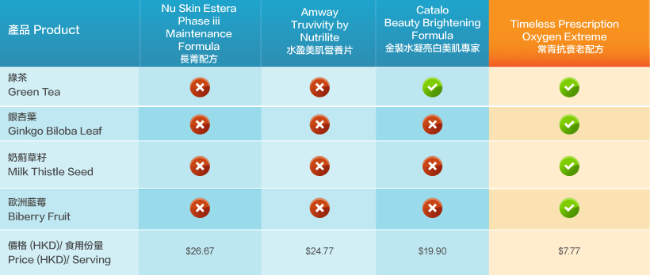
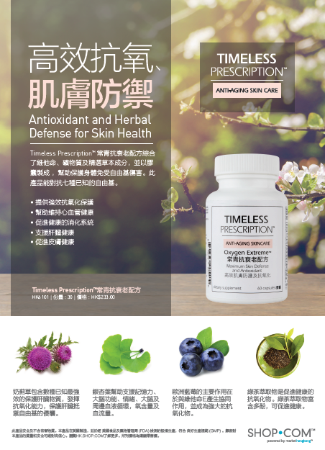
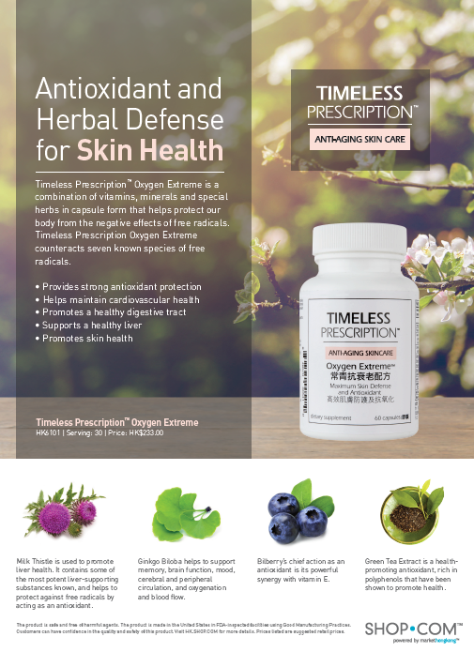
VS. Competitors & Sales Tool

Slide 66
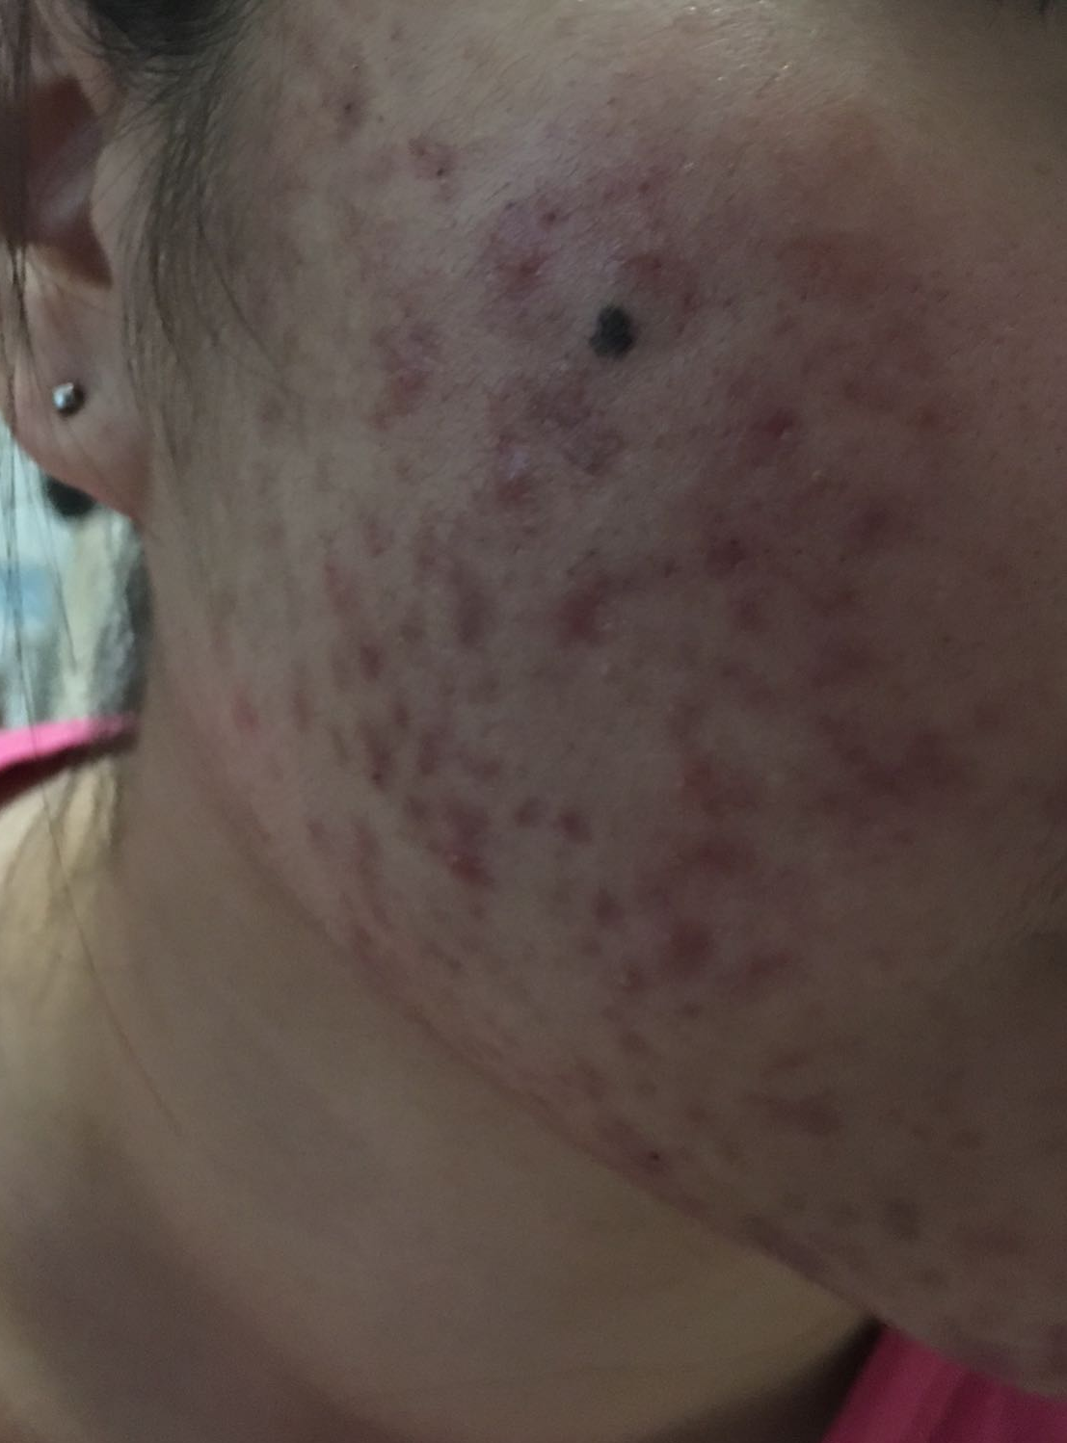
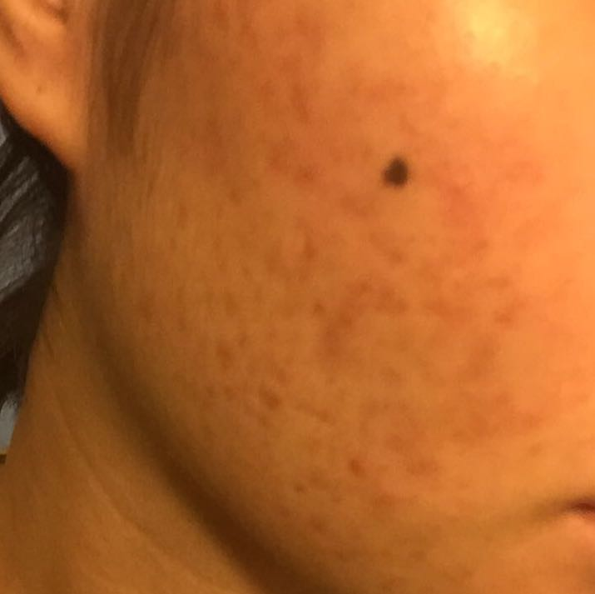
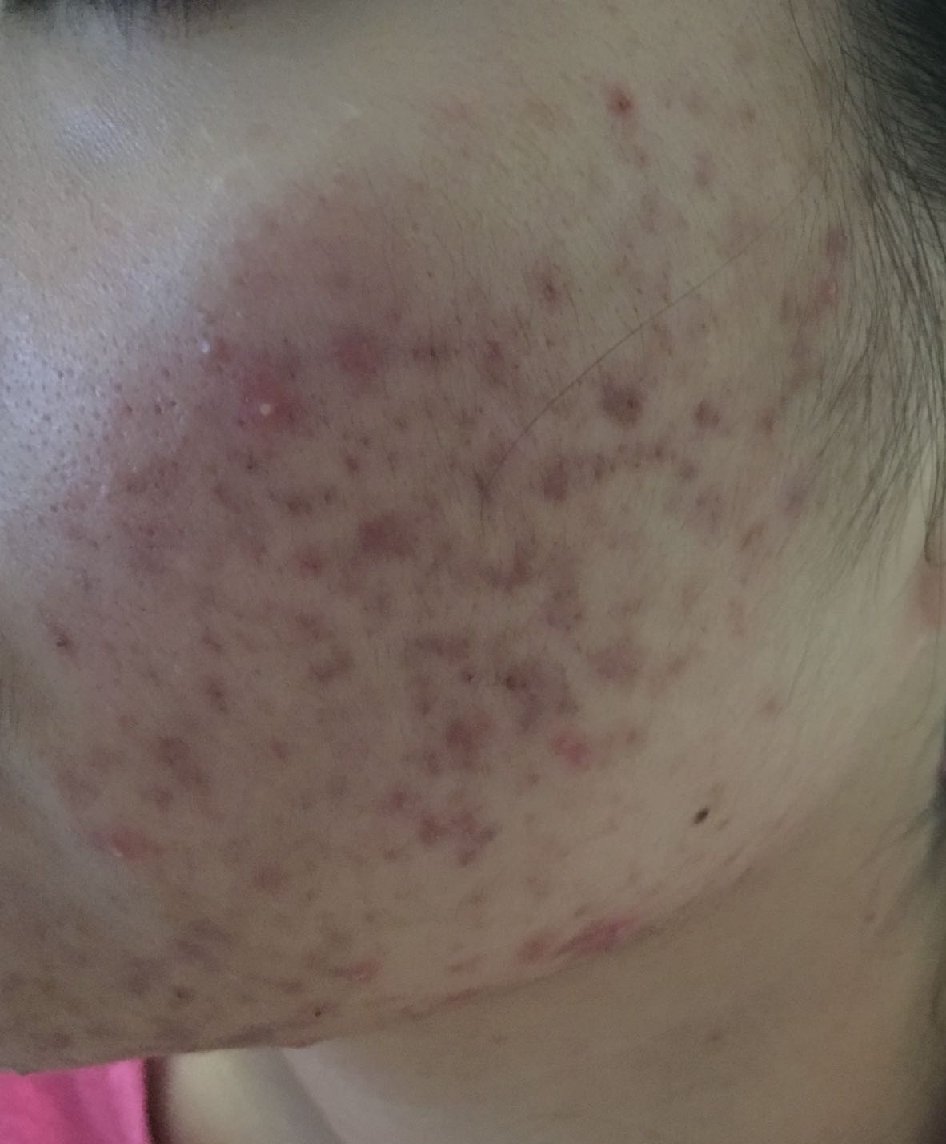
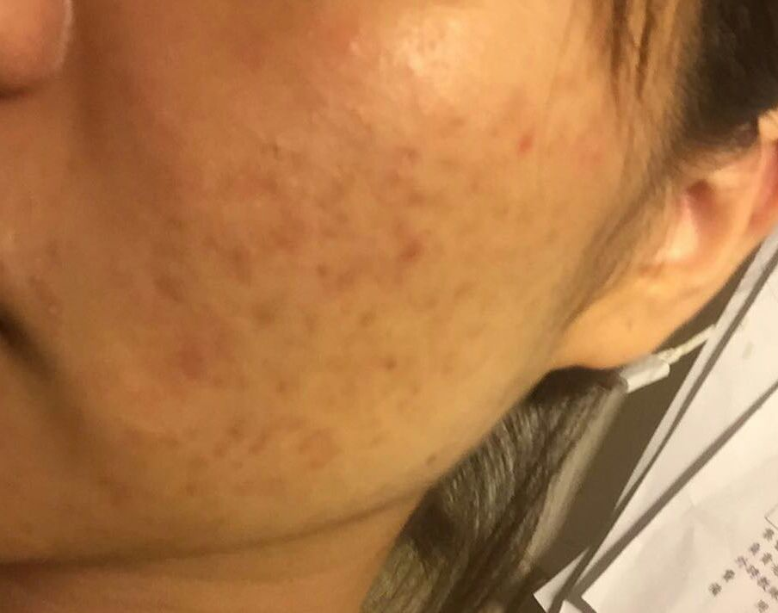
TESTIMONIAL
AFTER
3+ months after product usages
BEFORE
The testimonial made is for reference only and do not represent those of Market Hong Kong.

Slide 67
More to come…

